Slide 1
The Structure of the Web

Slide 2
Questions
How many people use the web?
What is the size of the web?
How many web sites are there?
How many searches per day?
How do web pages change?
What is the graph structure of the web?
How could the structure arise?
What can we do with link analysis?

Slide 3
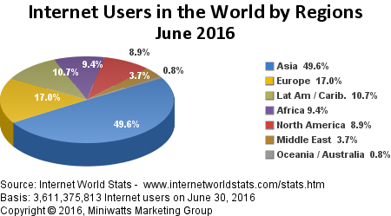
Global Internet Statistics
49.5% of world population is online
91.6% online in the UK
96.3% online is Norway
73.5% online in Europe
89.0% online in USA
See more stats by following the link.

Slide 4
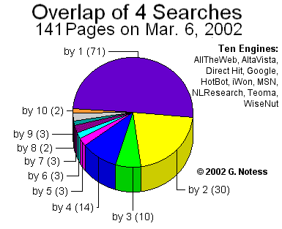
The Size of the Web
Lawrence and Giles 1999 – initial estimate of 800 million web pages
Over 10 Billion in 2005.
Trillions in 2016.
Coverage – about 40% in 1999
Overlap - low
The deep (or hidden or invisible) web contains 400-550 times more information.

Slide 5
Capture Recapture
SE1 – reported size of search engine 1.
Q – set of queries.
QSE1 and QSE2 - pages returned for Q from two engines.
OVR – overlap of QSE1 and QSE2.
Estimate of Web size: (QSE2 x SE1) / OVR

Slide 6
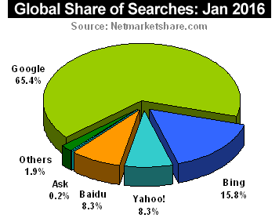
Search Engine Statistics
Google has over 3.5 billion searches a day
January 2016– Google has 65.4% searches.
How much time do users spend on the internet per day? About 3 hours (Google it yourself.)

Slide 7
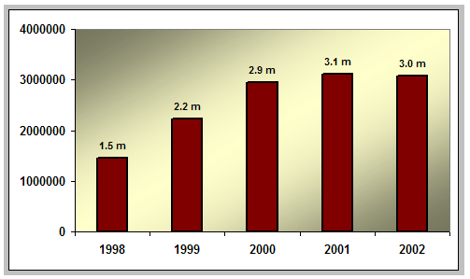
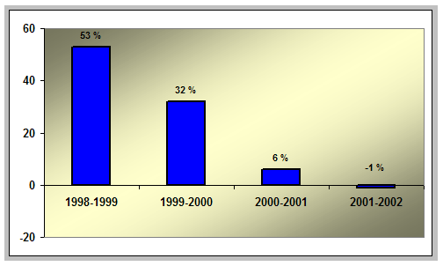
Growth in number of Public Sites
Number of web sites identified by capture-recapture method by sampling random IPs.
Average size of web site 441 pages.
Decrease in 2002 – no rush to get online, economic factors.

Slide 8
How do Web Pages Change
Most pages do not change much.
Larger pages change more often.
Commercial pages change more often.
Past change to a web page is a good indicator of future change.
About 30% of pages are very similar to other pages, and being a near-duplicate is fairly stable.

Slide 9
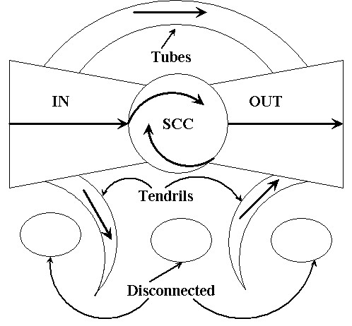
Bowtie Model of the Web
Broder et al. 1999 – crawl of over 200 million pages and 1.5 billion links.
SCC – 27.5%
IN and OUT – 21.5%
Tendrils and tubes – 21.5%
Disconnected – 8%

Slide 10
Diameter of the Web
Compute Average shortest path between pairs of pages that have a path from one to the other.
Broder 99 – directed 16.2, undirected 6.8
Barabasi 99 – directed for nd.edu 19
Small diameter is a charactersitic of a small world network
Choose random source and destination – 75% of the time no directed path between them.

Slide 11
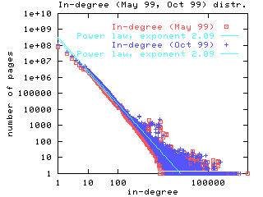
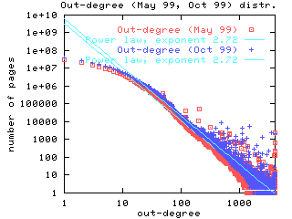
Web Structure Distributions
Average out-degree between 7 and 8
Degree distributions – how many page have n=1,2,… links:
indegree :
outdegree :
Log-log plots

Slide 12
What is a Power Law
f(i) is the proportion of objects having property i
E.g. f(i) = # pages, i = # inlinks
E.g. f(i) = # sites, i = # pages
E.g. f(i) = # sites i = # users
E.g. f(i) = frequency of word , i = rank of word, from most freqeunt to least frequent
Log-log plot - linear relationship (straight line)

Slide 13
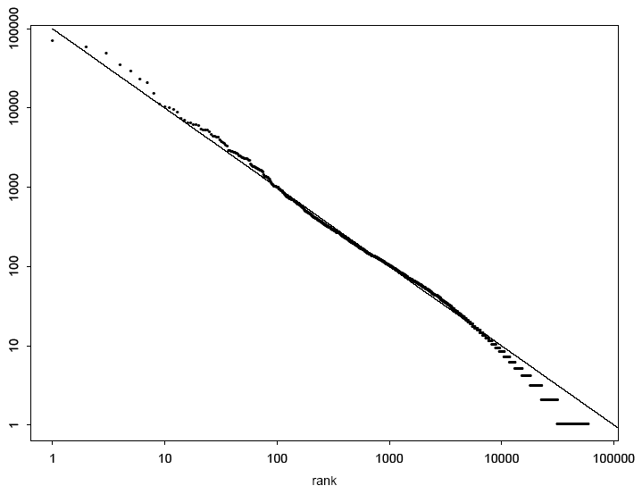
Zipf’s Distribution for Brown Corpus (1 million words – f(r) approx. C/r)

Slide 14
Word Frequency for Brown Corpus
 | Word | Instances | % Frequency
1. | The | 69970 | 6.8872
2. | of | 36410 | 3.5839
3. | and | 28854 | 2.8401
4. | to | 26154 | 2.5744
5. | a | 23363 | 2.2996
6. | in | 21345 | 2.1010
7. | that | 10594 | 1.0428
8. | is | 10102 | 0.9943
9. | was | 9815 | 0.9661
10. | He | 9542 | 0.9392

Slide 15
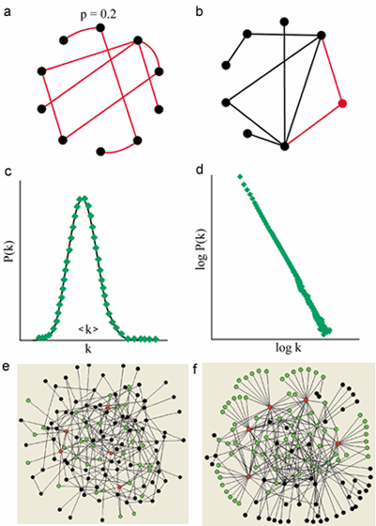
Evolving Random Networks
Classical random graphs – all links have the same probability p – degree distribution is poisson
Evolving networks – log-log degree distribution is linear
Model – add new node and randomly link to it with probability p, or with probability 1-p choose an existing node with proportion to its inllinks.

Slide 16
How Power Laws Arise -Preferential Attachment or The Rich Get Richer

Slide 17
Power Laws on the Web
inlinks (2.1)
outlinks (2.72)
Strongly connected components (2.54)
No. of web pages in a site (2.2)
No. of visitors to a site during a day (2.07)
No. links clicked by web surfers (1.5)
PageRank (2.1)

Slide 18
Robustness and Vulnerability of Power Law Networks
The web is extremely robust against attacks targeted at random web sites.
The web is vunerable against an attack targeted at well-connected nodes.
Has implications, e.g. on the spread of viruses on the Internet.

